Slide 1
Development of a comprehensive computational fluid dynamic (CFD) and discrete element model of biomass fast pyrolysis in a bubbling fluidized bed reactor
Ross Houstonª, Oluwafemi Oyedejiª, and Nourredine Abdoulmoumine^{a,b}
ªBiosystems Engineering and Soil Science Department, University of Tennessee, Knoxville, TN 37996
^{b}Center for Renewable Carbon, University of Tennessee, Knoxville, TN 37996
Presented at NETL’s 2017 Workshop on Multiphase Flow Science

Slide 2
Biomass Pyrolysis
Definition: Thermal decomposition of biomass in the absence of oxygen at moderate temperatures (450-600°C).
Produces three types of products:
Solid (char)
Condensable, organic liquid (bio-oil)
Non-condensable gases (CO, CO₂, H_{2,} CH₄)
Complex process:
Varying feedstock composition
Kinetics not fully understood
Notes:
Speak on why biomass pyrolysis is an attractive renewable energy process
biomass availability
produces a liquid fuel product

Slide 3
Rapid screening through simulation
Fluid (Gas)
Saves time and money
Allows for visualization and understanding of the complex environment inside the reactor
Applies conservation laws of mass, momentum, and energy to account for the coupling of transport types
Heat
Heat
Momentum
Momentum
Mass
Biomass (Solid)
Heat
Sand (Solid)
Momentum
Figure 1: Schematic of interactions between phases. Adapted from Mellin et al. (2013)

Slide 4
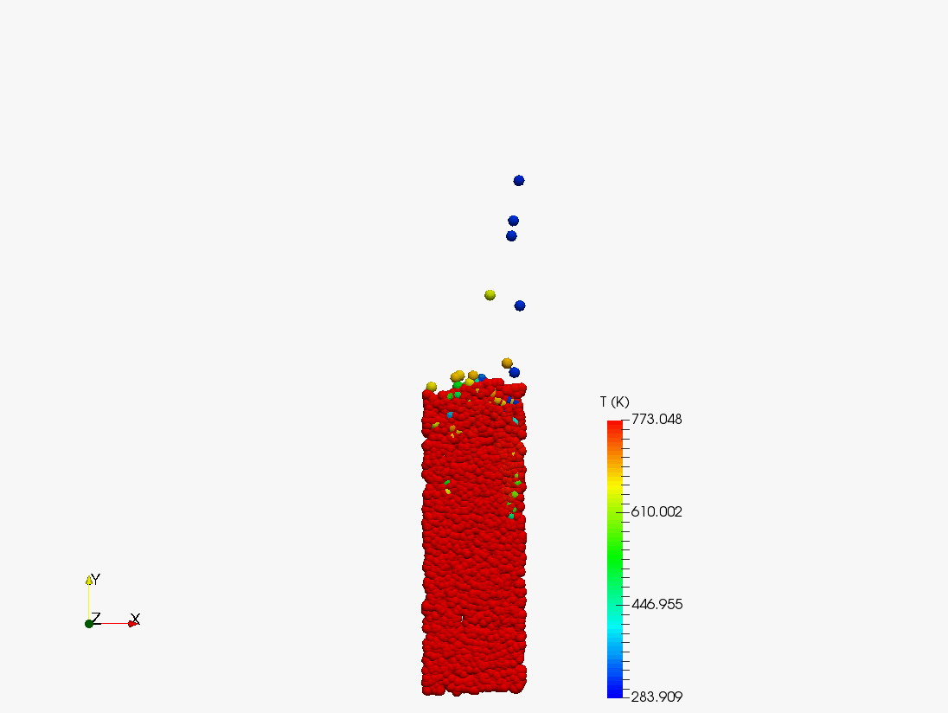
Project Objective
The purpose of this research is to model biomass fast pyrolysis by utilizing a CFD model paired with a discrete element method (DEM) framework and existing comprehensive reaction schemes for pine and switchgrass feedstocks.
Particle Collision
Mass Transport
Heat Transfer Model
Devolatilization
Momentum Transport
Energy Transport
Figure 2. Examples of models needed to simulate fast pyrolysis through CFD.

Slide 5
OpenFOAM
Free, open-source C++ CFD software
Completely modifiable code
Existing models for coal combustion
Ease of incorporating complex reaction kinetics
Potential to make the developed code available to the public
UTK High Performance Computer

Slide 6
Why DEM?
Pros:
Tracks each individual solid particle
Allows for particle size distribution
Irregular particle shape
More accurate representation of what happens to biomass
Cons:
Computationally expensive
Slower than Eulerian-Eulerian
We are concerned with the affect physical properties of biomass particles have on biomass fast pyrolysis.

Slide 7
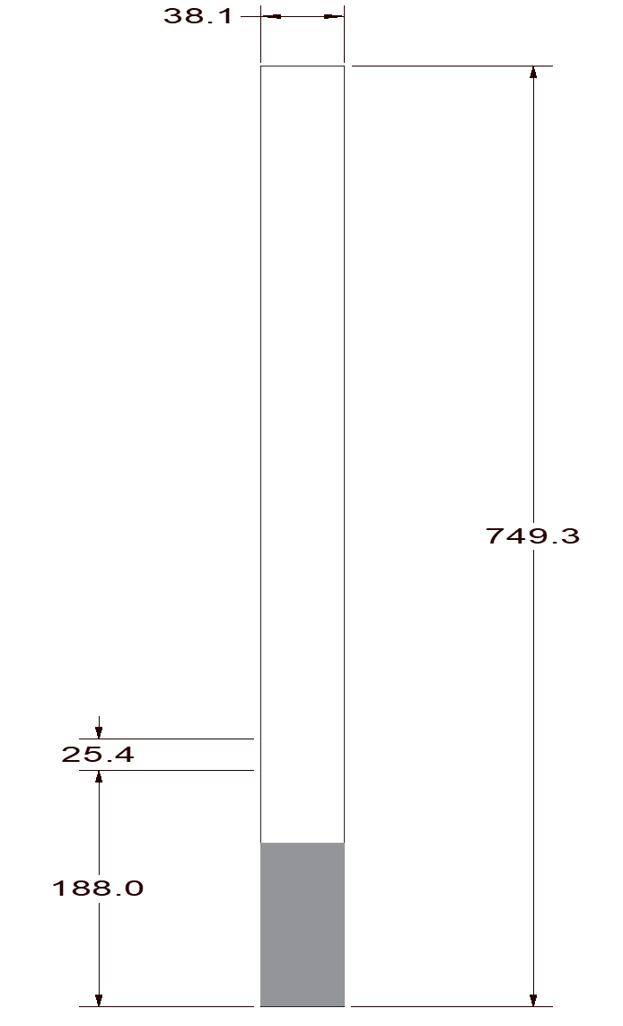
Materials and Methods Experimental Setup
Bench scale bubbling fluidized bed reactor
Diameter: 38.1 mm (1.5 in.)
Height: 749.3 mm (29.5 in.)
Reaction temperature
773 K
Two feedstocks
Pine
Switchgrass
Biomass inlet (total)
10 g/min
Sand (total)
200 g
Fluidizing gas velocity
0.5 m/s
Biomass Inlet
Sand
Figure 3. Reactor dimensions used for the CFD geometry.
N₂ Inlet
*Units in mm

Slide 8
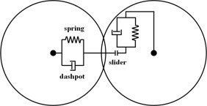
Materials and Methods Model Implementation
Solid Phase (Lagrangian)
Fluid Force: Gidaspow Contact Force: Hertz-Mindlin (Hertzin Spring Dashpot Model)
$$β=\left\{\begin{aligned}150\frac{ε_{p}^{2}μ_{g}}{ε_{g}^{2}d_{g}^{2}}+1.75\frac{ε_{p}ρ_{g}}{ε_{g}d_{p}}\left|U_{g}−U_{p}\right| ε_{g}<0.8 \\ 0.75C_{d}\frac{ε_{p}ρ_{g}}{d_{p}}\left|U_{g}−U_{s}\right|ε_{g}^{−2.65} ε_{g}≥0.8\end{aligned}\right.$$
$$C_{d}=\left\{\begin{aligned}\frac{24}{{Re}_{p}}\left(1+0.15{Re}_{p}^{0.687}\right){ Re}_{p}<1000 \\ 0.44 {Re}_{p}≥1000\end{aligned}\right.$$
$$F_{g}=\frac{βV_{p}}{ε_{p}}\left(U_{g}−U_{p}\right)$$
$${Re}_{p}=\frac{ε_{g}ρ_{g}d_{p}\left|U_{g}−U_{p}\right|}{μ_{g}}$$
$U_{p}:$Velocity of Particle
$U_{g}:$Velocity of gas
$F_{g}:$Fluid Force
$F_{p}:$ Particle/Wall Force
$β$: Moment Exchange
$V_{g}:$ Particle Volume
$ε_{g}:$Gas Volume Fraction
$ε_{p}:$Solid Volume Fraction
$μ_{g}:$ Gas Viscosity
$ρ_{g}$: Gas Density
$d_{p}$: Particle Diameter
$C_{d}$: Drag Coefficient
${Re}_{p}$: Particle Reynold’s Number
$S_{p}:$ Mass Source
$τ$: Stress Tensor
$S_{m}:$ Momentum Source
$E:$ Energy
$p$: Pressure
$α_{eff}:$ Thermal Diffusivity
$S_{h}:$ Reaction Enthalpy Source
$S_{p,h}:$ Particle Enthalpy Source
$S_{rad}:$ Radiation Source
$Y_{i}:$ Species Mass Fraction
$D_{eff}$: Mass Diffusion Constant
$S_{p,Y_{i}}:$ Particle Species Source
$S_{Y_{i}}:$ Reaction Species Source
Continuous Phase (Eulerian)
Turbulence Model: K-ε model
Energy Conservation:
Mass Conservation:
$$\frac{δ}{δt}\left(ε_{g}ρ_{g}E\right)+∇∙\left(ε_{g}{U_{g}(ρ}_{g}E+p) \right)={∇∙\left(ε_{g}α_{eff}∇h_{s}\right)+S}_{h}+S_{p, h}+S_{rad}$$
$$\frac{δ}{δt}\left(ε_{g}ρ_{g}\right)+∇∙\left(ε_{g}ρ_{g}U_{g}\right)=S_{ρ}$$
$$E=h_{s}−\frac{p}{ρ_{g}}+\frac{U_{g}^{2}}{2}$$
Momentum Conservation:
Chemical Species Conservation:
$$\frac{δ}{δt}\left(ε_{g}ρ_{g}U_{g}\right)+∇∙\left(ε_{g}ρ_{g}U_{g}U_{g}\right)={−∇p+∇∙\left(ε_{g}τ\right)+ε_{g}ρ_{g}g+S}_{m}$$
$$\frac{δ}{δt}\left(ε_{g}ρ_{g}Y_{i}\right)+∇∙\left(ε_{g}ρ_{g}{U_{g}Y}_{i}\right)=∇∙\left(ε_{g}{ρ_{g}D}_{eff}∇Y_{i}\right)+S_{p,Y_{i}}+S_{Y_{i}}$$

Slide 9
Materials and Methods Submodels
Heat Transfer: Ranz Marshall
Heterogeneous Reactions:
Combustion Model:
Partially Stirred Reactor (PaSR)
$$h=\frac{6∝_{p}k_{g}{Nu}_{p}}{d_{p}^{2}}$$
$$C + H_{2}O→ CO + H_{2}$$
$$C + {CO}_{2} →2CO$$
$$Pr=\frac{C_{pg}μ_{g}}{k_{g}}$$
$h:$ Heat Transfer Constant
$∝_{p}$: Particle Volume Fraction
$K_{g}$: Thermal Conductivity
${Nu}_{p}:$ Nusselt Number
$d_{p}:$ Particle Diameter
$Pr$: Prandtl Number
$C_{pg}:$ Gas Heat Capacity
$μ_{g}:$ Gas Viscosity
${Re}_{p}:$ Particle Reynold Number
$m_{p}$: Particle Mass
$ρ_{p}:$ Particle Density
$M_{carb}:$ Particle Carbon Mass
$t$: Time
$A_{p}:$ Particle Surface Area
$p_{i}:$ Gas Partial Pressure
$r_{diff, i}:$ Diffusion Rate Constant
$r_{kin, i}:$ Kinetic Rate Constant
$C$: Mass Diffusion Constant
$T_{p}:$ Particle Temperature
$T_{g}:$ Gas Temperature
$a$: Absorption coefficient
$σ_{s}$: Scattering coefficient
G: Incident radiation
$C_{f}$: Linear-anisotropic phase function coefficient
$$\frac{{dM}_{carb}}{dt}=−A_{p}p_{i}\frac{r_{diff,i}r_{kin,i}}{r_{diff,i}+r_{kin,i}}$$
Transport Model: Newtonian
Constant viscosity
$${Nu}_{p}=2+0.6{Re}_{p}^{0.5}{Pr}^{0.33}$$
$$r_{diff,i}=C\frac{{\left(0.5\left(T_{p}+T_{g}\right)\right)}^{0.75}}{d_{p}}$$
Particle Shrinkage Model:
$$d_{p}={\left(\frac{6m_{p}}{πρ_{p}}\right)}^{0.333}$$
$$r_{kin,i}=A_{i}T_{p}e^{{−E_{i}}/{RT_{p}}}$$
Phase Change:
Liquid Evaporation
Radiation Model: P1
$$q_{r}=−\frac{1}{3\left(a+σ_{s}\right)−C_{f}σ_{s}}$$
Notes:
PaSR-derives reaction rates in a transient manner based on a turbulent time scale as well as a kinetic time scale
https://openfoamwiki.net/images/8/8a/Christ_OFW6_slides.pdf

Slide 10
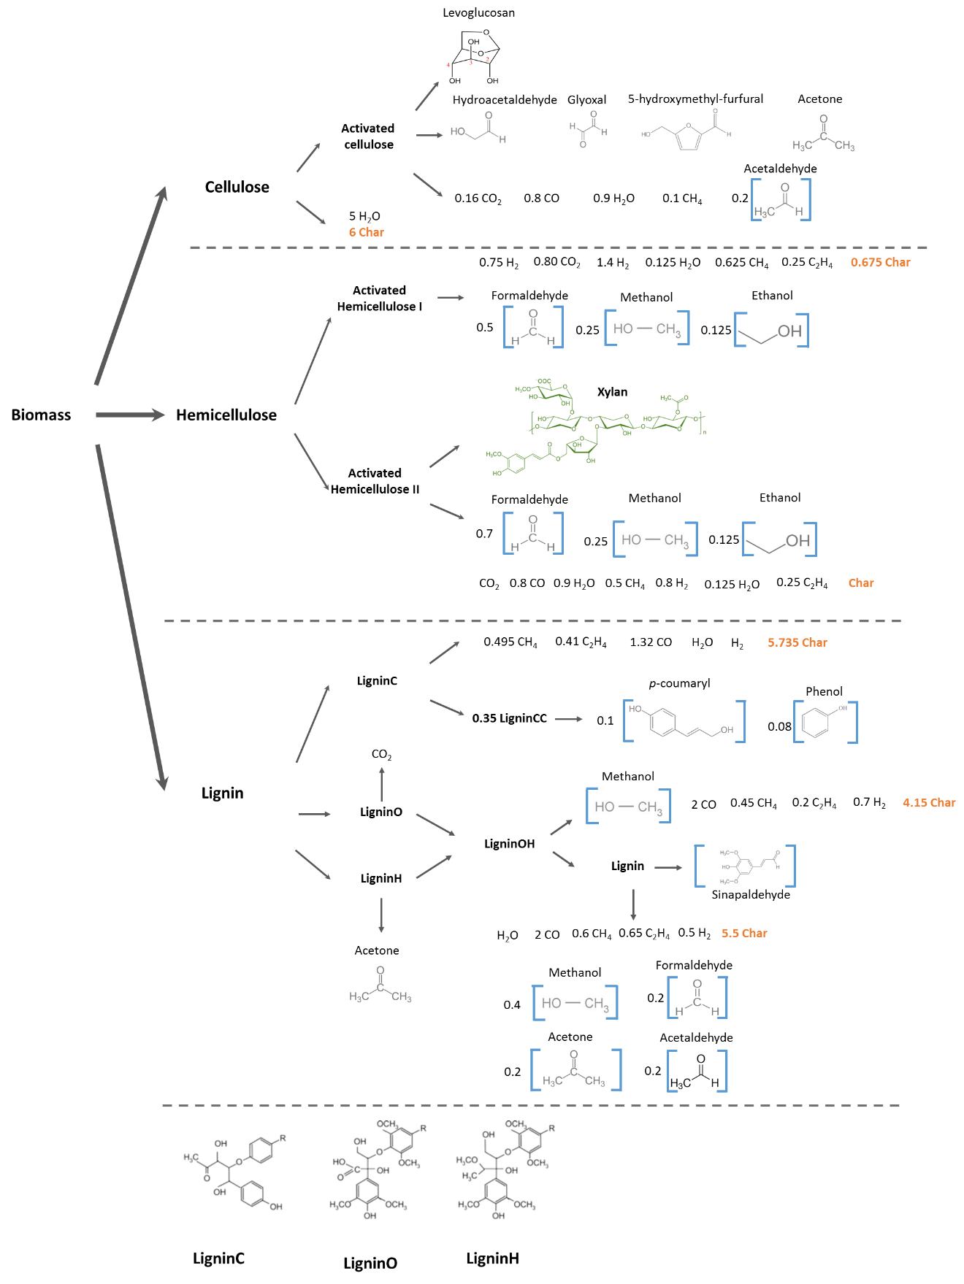
Materials and Methods Reaction Scheme
Table 1. Examples of the Primary pyrolysis reactions used in the CFD model
Reaction |  | A (s⁻¹) | E (kJ/mol) | ∆h (kJ/kg)
1 | Cellulose → Activated Cellulose | 8x10¹³ | 192.5 | 447.7
2 | Cellulose→ 5H₂O + 6Char | 8x10⁷ | 125.5 | -1087.8
3 | Activated Cellulose → Levoglucosan | 4T | 41.8 | 732.2
Reaction Rate: Modified Arrhenius
$$k_{i}=A∗T^{β}e^{\left(\frac{{−E}_{A}}{RT}\right)}$$
Note: Typical values for $β$ = 0
Figure 4. Comprehensive pyrolysis reaction tree. Adapted from Mellin (2013).
Source: Mellin, P., Kantarelis, E., & Yang, W. (2014). Computational fluid dynamics modeling of biomass fast pyrolysis in a fluidized bed reactor, using a comprehensive chemistry scheme. Fuel, 117, Part A, 704-715. doi:http://dx.doi.org/10.1016/j.fuel.2013.09.009
Blondeau, J., & Jeanmart, H. (2012). Biomass pyrolysis at high temperatures: Prediction of gaseous species yields from an anisotropic particle. Biomass and Bioenergy, 41, 107-121. doi:https://doi.org/10.1016/j.biombioe.2012.02.016

Slide 11
Feedstock Characteristics
Two Feedstocks:
Switchgrass
Pine
Particle Diameter:
Biomass: 0.85 mm
Sand: 0.5 mm
Particle Density:
Biomass: 600 kg/m³
Sand: 2650 kg/m³
Table 1. Chemical composition of each feedstock by weight percentª.
Component | (wt. %)
 | Switchgrass | Pine
Cellulose | 45.0 | 45.0
Hemicellulose | 27.0 | 26.0
Lignin-C | 6.7 | 8.8
Lignin-H | 6.7 | 8.8
Lignin-O | 6.7 | 8.7
Moisture | 3.7 | 2.0
Ash | 4.2 | 0.7
ªHumbird, D., Trendewicz, A., Braun, R., & Dutta, A. (2017). One-Dimensional Biomass Fast Pyrolysis Model with Reaction Kinetics Integrated in an Aspen Plus Biorefinery Process Model. ACS Sustainable Chemistry & Engineering, 5(3), 2463-2470. doi:10.1021/acssuschemeng.6b02809

Slide 12
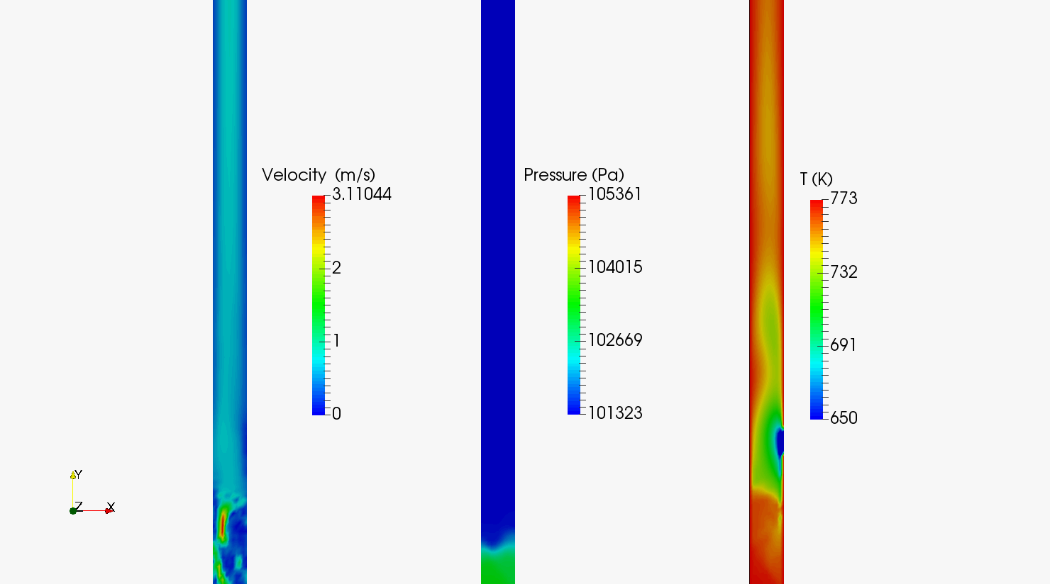
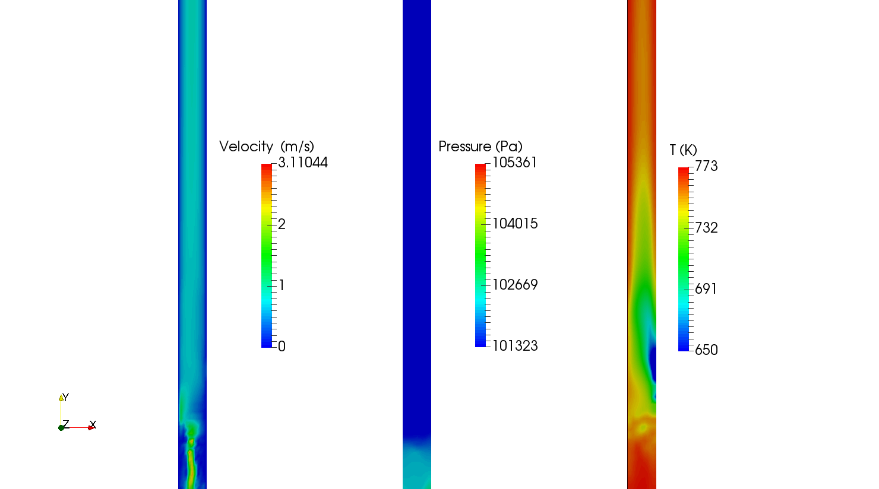
Results
Physical Properties-Switchgrass
Results
Physical Properties-Pine
Figure 5: Visualization of physical properties during pyrolysis of switchgrass for 6.00-6.92 seconds.
Figure 6: Visualization of physical properties during pyrolysis of pine for 6.00-6.52 seconds.

Slide 13
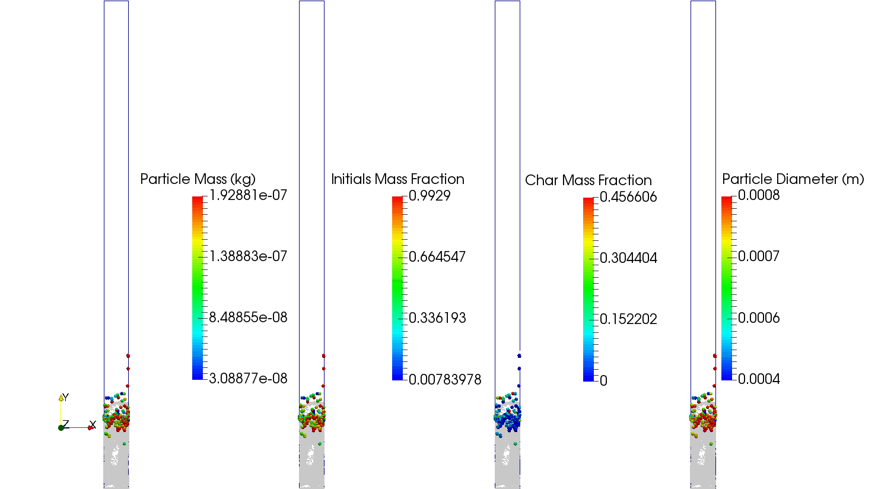
Results Solids Evolution-Switchgrass
Results
Solids Evolution-Pine
Figure 8: Production of intermediate solids during pyrolysis of pine for 6.00-6.52 seconds.
Figure 7: Production of intermediate solids during pyrolysis of switchgrass for 6.00-6.92 seconds.

Slide 14
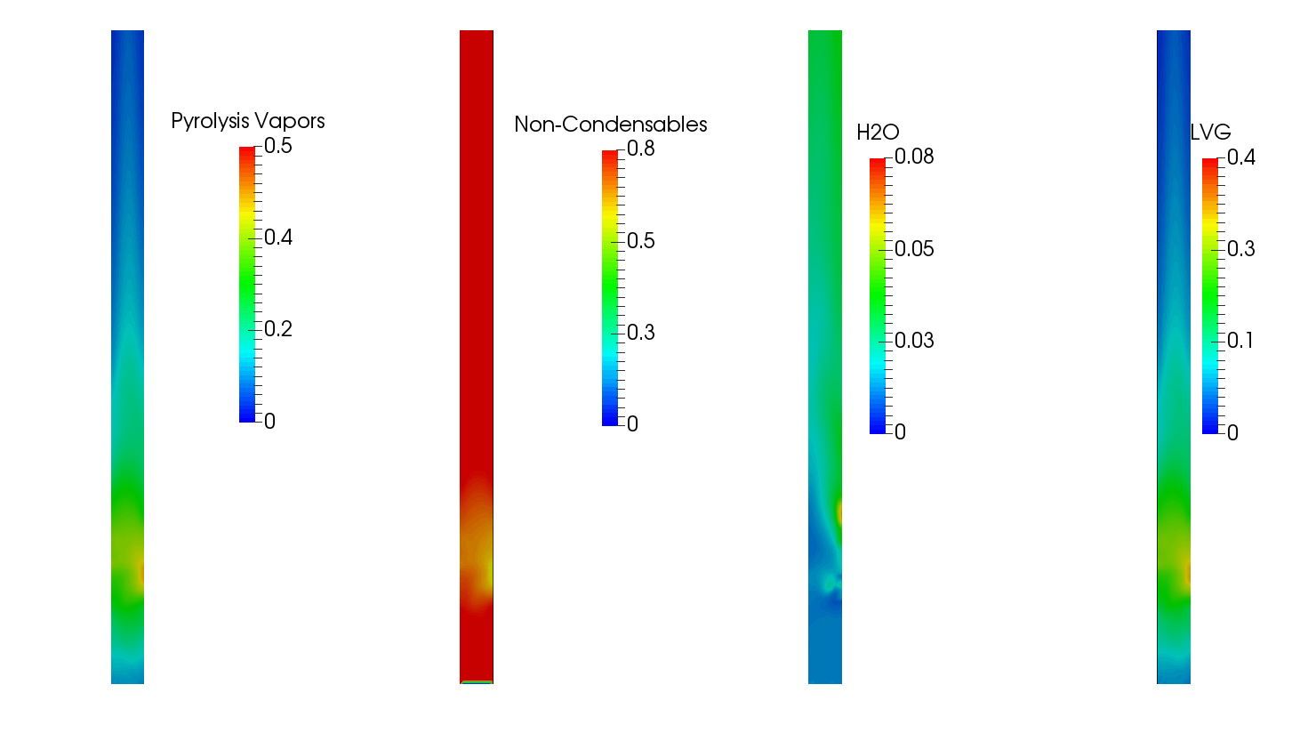
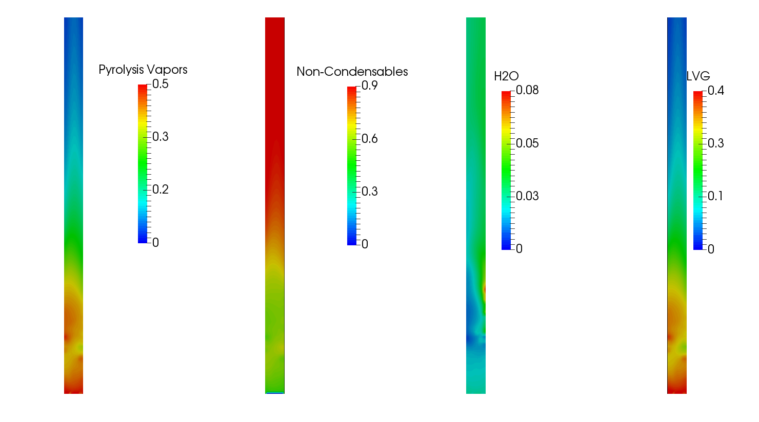
Results Gas Evolution-Switchgrass
Results
Gas Evolution-Pine
Yield:
50% of biomass has been converted to the gas phase
*Changes have been made to secondary reaction kinetics to slow down cracking
Figure 10: Vapor phase mass fraction, on a nitrogen free basis, of pine for 6.00-6.52 seconds.
Figure 9: Vapor phase mass fraction, on a nitrogen free basis, of switchgrass for 6.00-6.92 seconds.

Slide 15
Conclusions
Approximately 3 seconds is required for biomass particles to enter pyrolysis temperatures (723 K) and particles are approaching reaction temperatures (773 K)
Species evolution along the length of the reactor is as expected
Increased NCG formation along the reactor as pyrolysis vapors undergo secondary cracking
The simulation has not reached steady state and most of the gases currently leaving the reactor are the light non-condensable gases
After the adjustment to the secondary reaction kinetics, bio-oil vapors are increasing in vapor mass fraction along the length of the reactor

Slide 16
Plans for Future Work
Update kinetic reaction scheme for newest fast pyrolysis mechanismª
Optimize physical parameters such as maximum packing limit, coefficient of restitution, and fluidization velocity
Change biomass composition to reflect previous analyses by the Center for Renewable Carbon (CRC)
Validate results on bench scale reactor located in the CRC
ªSource: Ranzi, E., Corbetta, M., Manenti, F., & Pierucci, S. (2014). Kinetic modeling of the thermal degradation and combustion of biomass. Chemical Engineering Science, 110, 2-12. doi:http://dx.doi.org/10.1016/j.ces.2013.08.014

Slide 17
Acknowledgements
The U.S. Department of Agriculture (USDA), the National Institute of Food and Agriculture (NIFA), and the Agriculture and Food Research Initiative (AFRI)
Grant number 2015-67021-24121.

Slide 18
Thank you
Questions?

